Slide 1

Leveraging NLP for Focused Ultrasound Research Taxonomy Development
Rose Eluvathingal Muttikkal, Abhishek Singh, Skye Jung, Reanna Panagides
May 1, 2024

Slide 2
Table of Contents
Project Purpose & Background
Data Discussion
Assumptions & Limitations
Modeling Methods
Solution

Slide 3

Project Purpose &
Background
Notes:
.

Slide 4

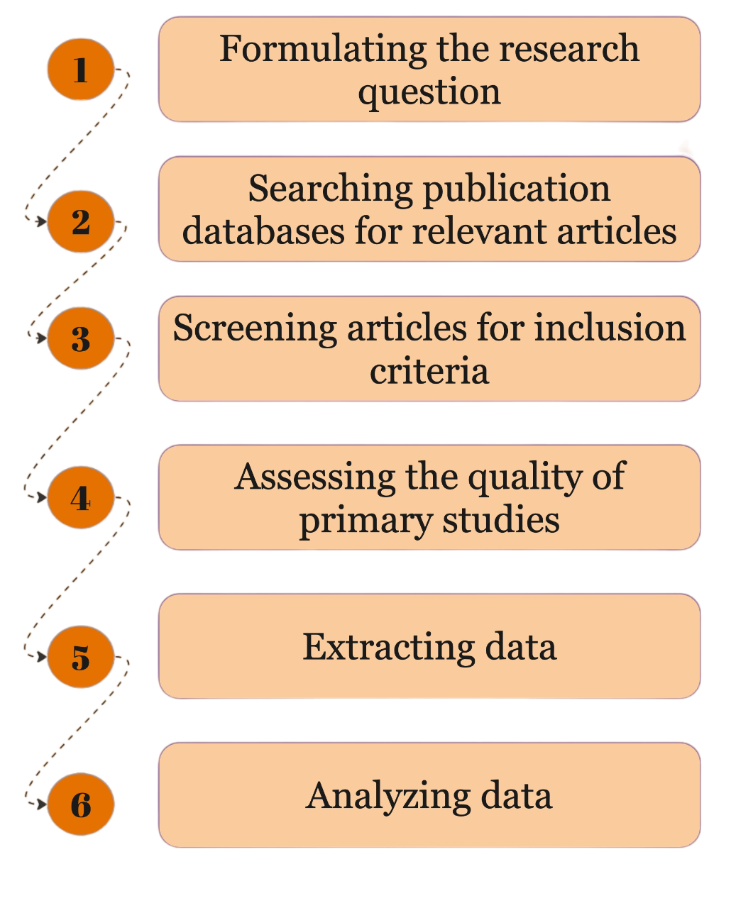
Project Purpose
Problem: The current literature review process for the clinical team at Focused Ultrasound Foundation (FUSF) is time-consuming, inefficient, and prone to error
Proposed solution: Utilize machine learning techniques to enhance the efficiency of classifying scientific literature about emerging applications of focused ultrasound therapies

Slide 5
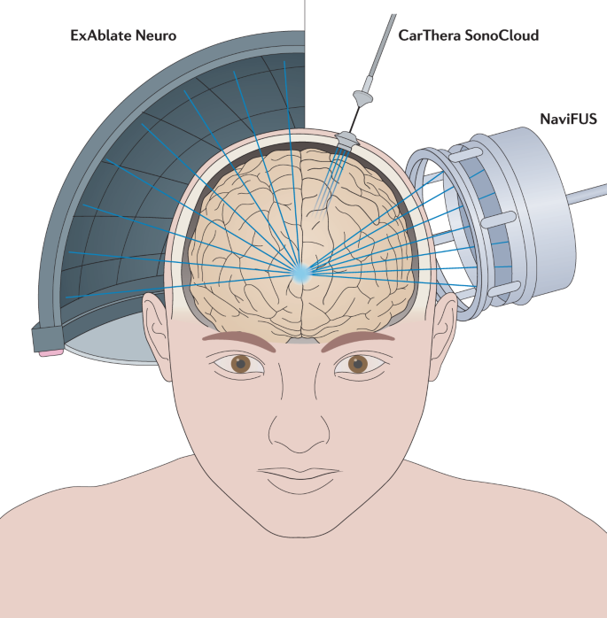
What is Focused Ultrasound (FUS)?
FUS is a non-invasive therapeutic technology that uses non-ionizing ultrasonic waves to heat or ablate tissue
Approved to treat various conditions
Essential tremor, uterine fibroids, Parkinson’s disease, fibroadenomas of the breast, melanoma and other solid tumors
Non-invasive nature → reduction in post-operative recovery time and risks
Growing number of published research on FUS therapies makes ML-assisted literature review a timely approach
Meng et al, 2021.

Slide 6
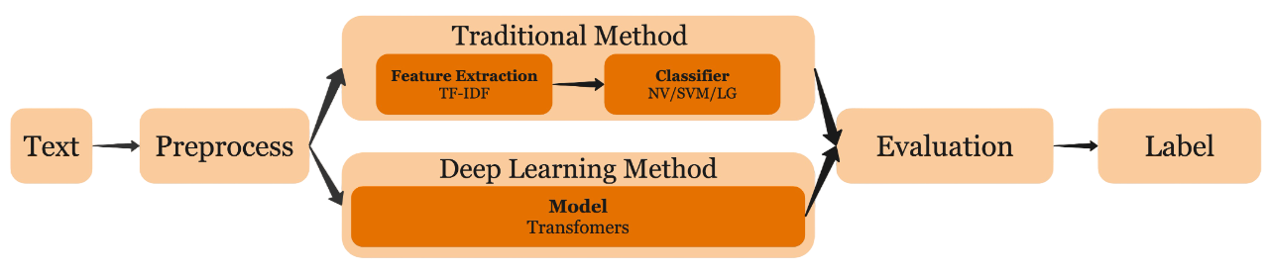
Brief Background on Text Classification
Adapted from Q. Li et al, 2021

Slide 7
Data Discussion

Slide 8
Data Discussion
Curated collection of scientific articles related to focused ultrasound and its applications within healthcare
Literature review excel files from Feb-Aug 2023
48 FUS related, 441 non-FUS
Updated dataset (1794 FUS related, 1794 non-FUS)
Dropped duplicates and missing data
Supplemented dataset
Previous intern’s data
FUSF Zotero database
Non-FUS articles from PubMed
Target Variables
FUS Identification
Data Challenges
Lack of Data
Imbalanced Data

Slide 9
Assumptions & Limitations

Slide 10
Assumptions
Limitations
Abstracts are representative of FUS-related literature
Labeling of FUS and non-FUS related articles are accurate
Model performance is maintained across variations in abstract characteristics such as length, writing style, publication year
Content of FUS-relevant abstracts may change over time (concept drift)
Absence of feedback loop for automatic adaptation to changing content
Model performance may diminish with new data patterns
May need period retraining to maintain model accuracy

Slide 11
Modeling Methods

Slide 12
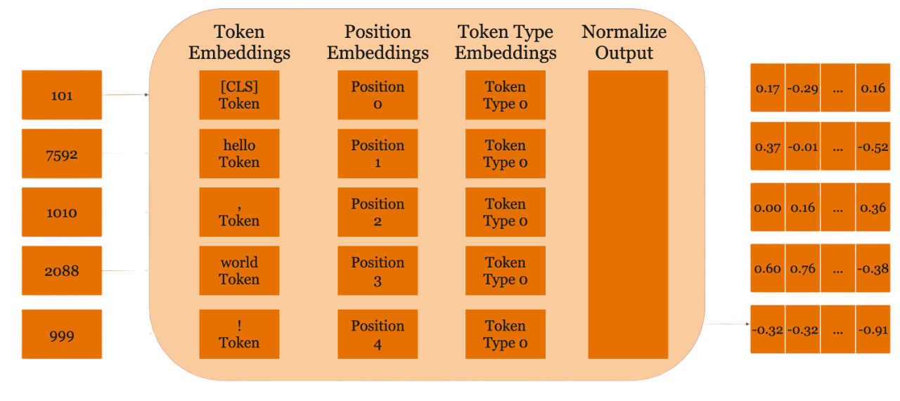
BERT (Bidirectional Encoder Representations from Transformers)
Transformer-based model developed in 2018 by researchers at Google AI Language
One of the first large language models (LLMs)
NLP tasks → question answering, sentiment analysis, text generation, summarizing text, language translation, autocomplete tasks
Adapted from BERT embeddings.

Slide 13
Pretrained Models
Model | Total parameters | Pre-training dataset | Train batch size | Learning rate | Epoch
TinyBERT | 14,350,874 | General domain corpora (Wikipedia, BookCorpus) | 16 | 5e-5 | 3
SciBERT | 109,920,002 | Semantic Scholar | 32 | 5e-5 | 3
DistilBERT | 66,955,010 | General domain corpora | 16 | 3e-5 | 3
Bio+ClinicalBERT | 108,311,810 | MIMIC III database | 8 | 3e-5 | 4

Slide 14
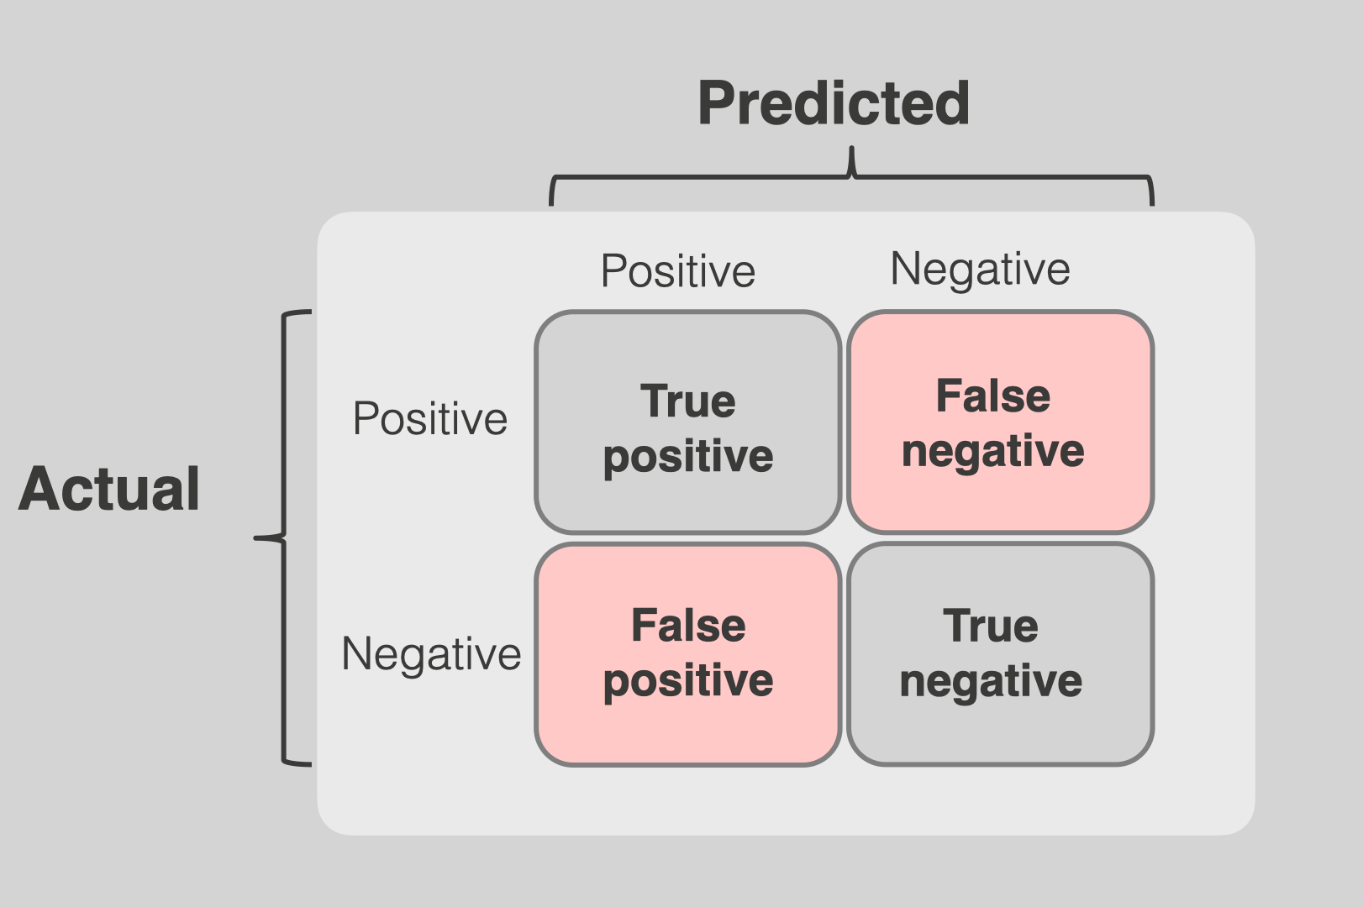
Model Performance Metrics
Metric | Definition | Equation
Accuracy | Proportion of true results (both true positives and true negatives) among the total number of cases examined | (TP + TN) /( TP + TN + FP + FN)
Precision | Proportion of true positive results in all positive predictions made by the model | (TP) /( TP + FP)
Recall | Proportion of true positive results among all actual positives | (TP) / (TP + FN)
F1 Metric | Harmonic mean of precision and recall, providing a single metric to balance the trade-off between the two | 2 * (Precision * Recall) / (Precision + Recall)

Slide 15
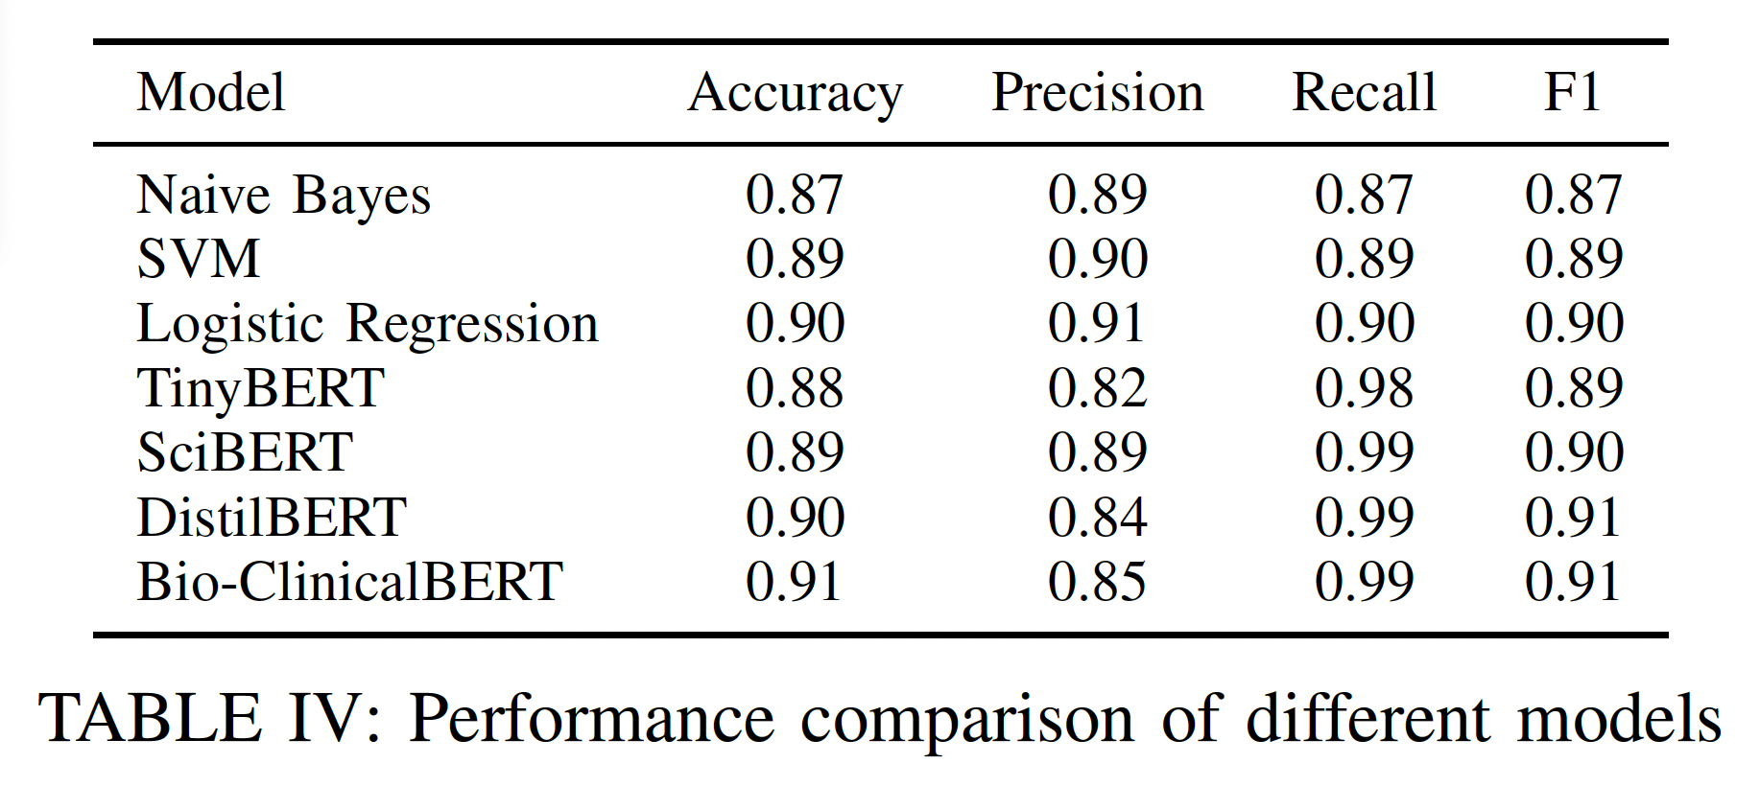
Model Performance on Test Data

Slide 16
Solution

Slide 17
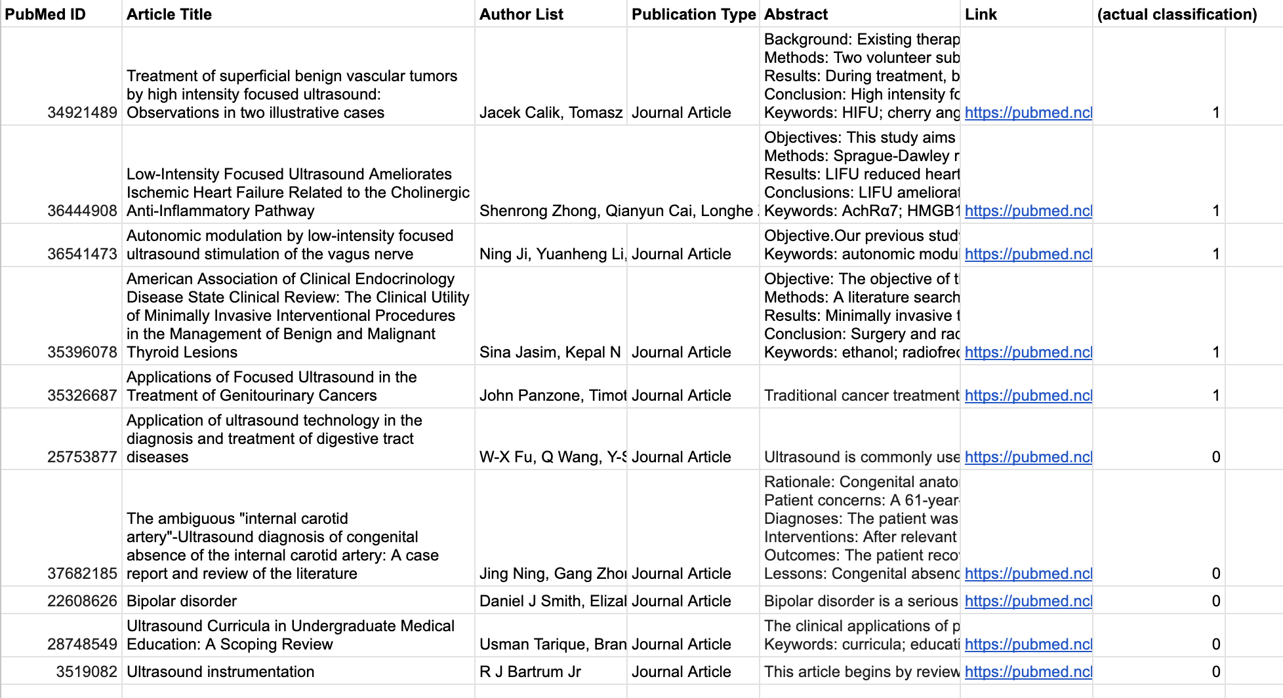
Model Input
Literature Review Excel File

Slide 18
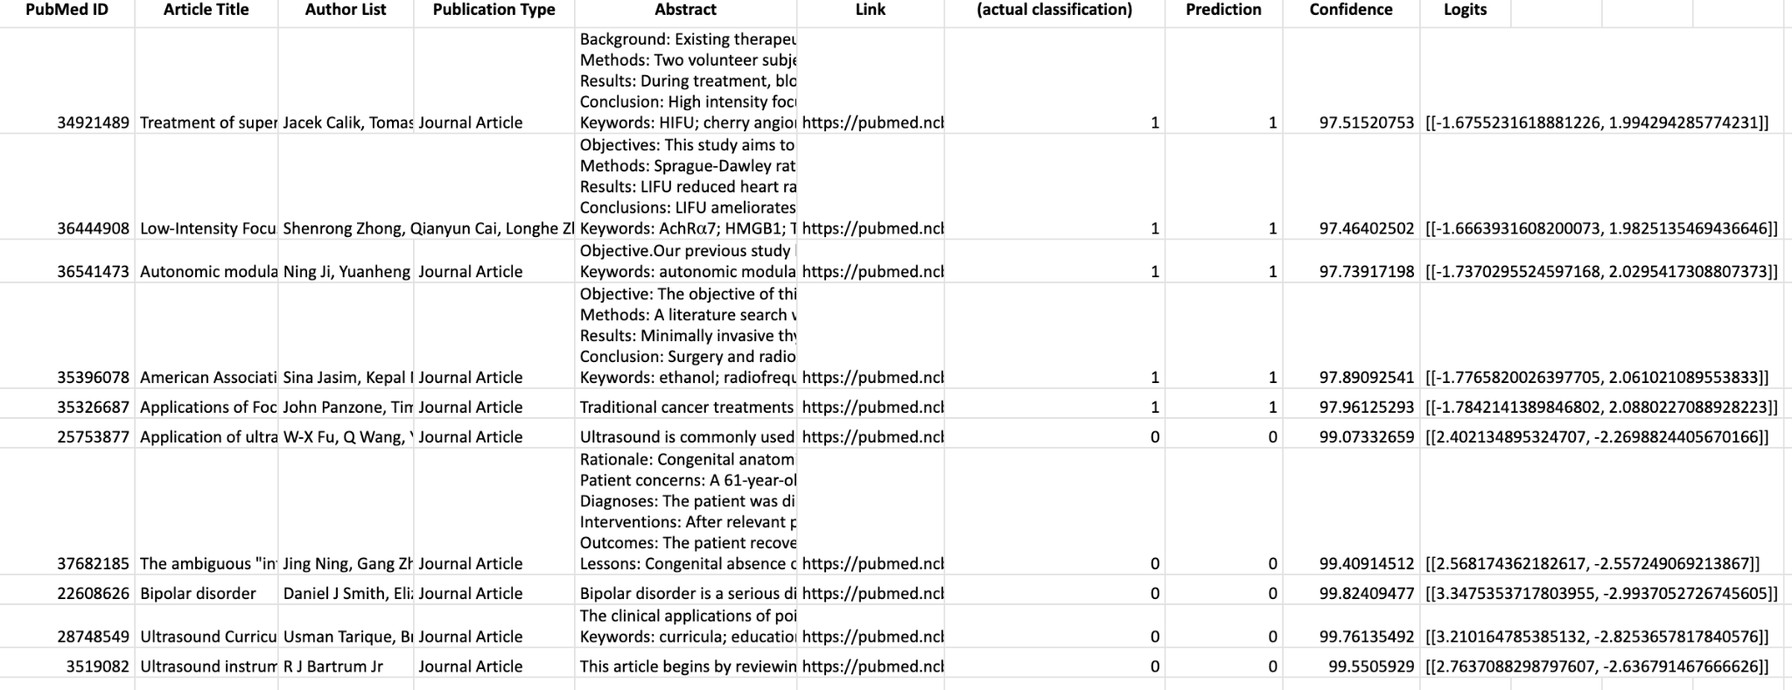
Model Output
Updated Literature Review Excel Sheet

Slide 19
Example FUS Classification
Title: Applications of Focused Ultrasound in the Treatment of Genitourinary Cancers
Abstract:
Traditional cancer treatments have been associated with substantial morbidity for patients. Focused ultrasound offers a novel modality for the treatment of various forms of cancer which may offer effective oncological control and low morbidity. We performed a review of PubMed articles assessing the current applications of focused ultrasound in the treatment of genitourinary cancers, including prostate, kidney, bladder, penile, and testicular cancer. Current research indicates that high-intensity focused ultrasound (HIFU) focal therapy offers effective short-term oncologic control of localized prostate and kidney cancer with lower associated morbidity than radical surgery. In addition, studies in mice have demonstrated that focused ultrasound treatment increases the accuracy of chemotherapeutic drug delivery, the efficacy of drug uptake, and cytotoxic effects within targeted cancer cells. Ultrasound-based therapy shows promise for the treatment of genitourinary cancers. Further research should continue to investigate focused ultrasound as an alternative cancer treatment option or as a complement to increase the efficacy of conventional treatments such as chemotherapy and radiotherapy. Keywords: cancer; review; treatment; ultrasound.
Insert Abstract into ‘predict_abstract’ function:

Slide 20
Example Non-FUS Classification
Title: Application of ultrasound technology in the diagnosis of digestive tract diseases
Abstract:
Ultrasound is commonly used in clinical examination which is economic, non-invasive and convenient. Ultrasound can be used for the examination of solid organs and hollow organs. Due to the presence of air, routine ultrasound examination of the digestive tract is not very appropriate, Because of the development of endosonography and its related technology, diagnosis of gastrointestinal diseases have been improved which is valuable in clinic. This review focused on the application of ultrasound technology in the diagnosis of digestive tract diseases.
Insert Abstract into ‘predict_abstract’ function:

Slide 21
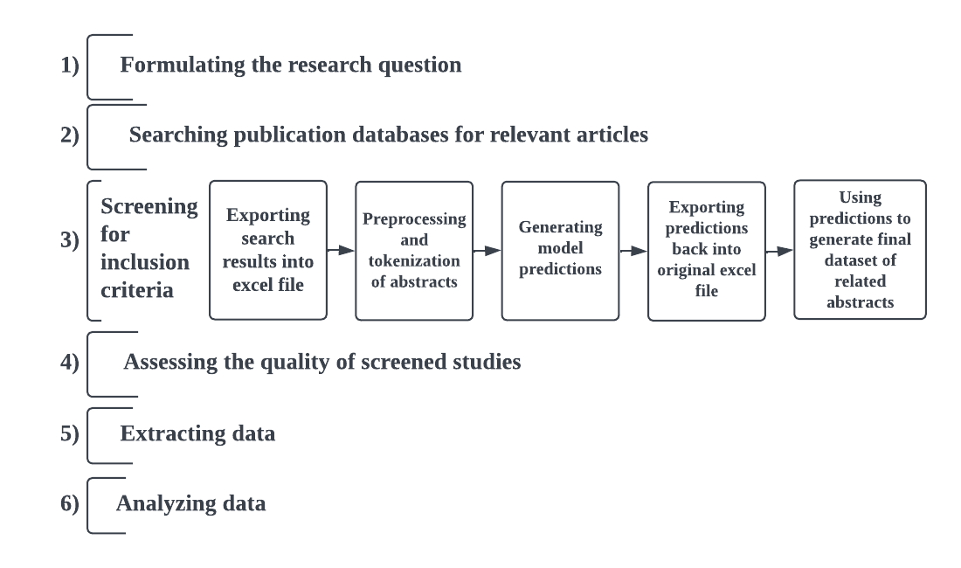
Conclusion
Future Work
Multi-class classification of FUS manuscript indications
Explore → other transformer architectures for text classification
Develop feedback loop into modeling pipeline to address concept drift
Model input
FusBERT
Model output
FUSF PubMed web scrapper
Python script

Slide 22



Acknowledgements
Sponsors
Faculty Mentor
Rick Hamilton
Managing Director, Chief Technology Officer
Rithika Anand
Biomedical Engineering Intern
Heman Shakeri
Assistant Professor of Data Science

Slide 23




MSDS Capstone Team
Reanna Panagides
Skye Jung
Abhishek Singh
Rose Eluvathingal Muttikkal

Slide 24
Thank you! Questions?

Slide 25
Why did we use BERT models?
How does BERT work?
Pre-trained on large amounts of text data using unsupervised methods, Masked Language Model (MLM) and Next Sentence Prediction
Uses a multi-layer bidirectional encoder
Context information to the left and right of a word → more nuanced semantic relationships
Fine-tuned (training on labeled tasks-specific data) to perform downstream tasks such as text classification
Transformers are the current state-of-the-art approach to text classification
Selected BERT → assess capability of earliest language model for FUS scientific manuscript classification
Our future work → explore other Transformer architectures for text classification in literature review

Slide 26
Linked Appendix
Title
Model Performance
Table of Contents
Model Input
Project Purpose
Model Output
What is FUS?
Example FUS Classification
Text Classification Background
Example non-FUS Classification
Data Discussion
Integrating to Workflow
Assumptions & Limitations
BERT
Pretrained Models
Model Performance Metrics

Slide 27
References
Meng, Y., Hynynen, K. & Lipsman, N. Applications of focused ultrasound in the brain: from thermoablation to drug delivery. Nat Rev Neurol 17, 7–22 (2021). https://doi.org/10.1038/s41582-020-00418-z
BERT embeddings. Section: blog. [Online]. Available: https://tinkerd.net/blog/machine-learning/bert-embeddings/
Q. Li, H. Peng, J. Li, C. Xia, R. Yang, L. Sun, P. S. Yu, and L. He, “A survey on text classification: From shallow to deep learning.” [Online]. Available: http://arxiv.org/abs/2008.00364

